Slide 1
Spring MVC PART 2

Slide 2
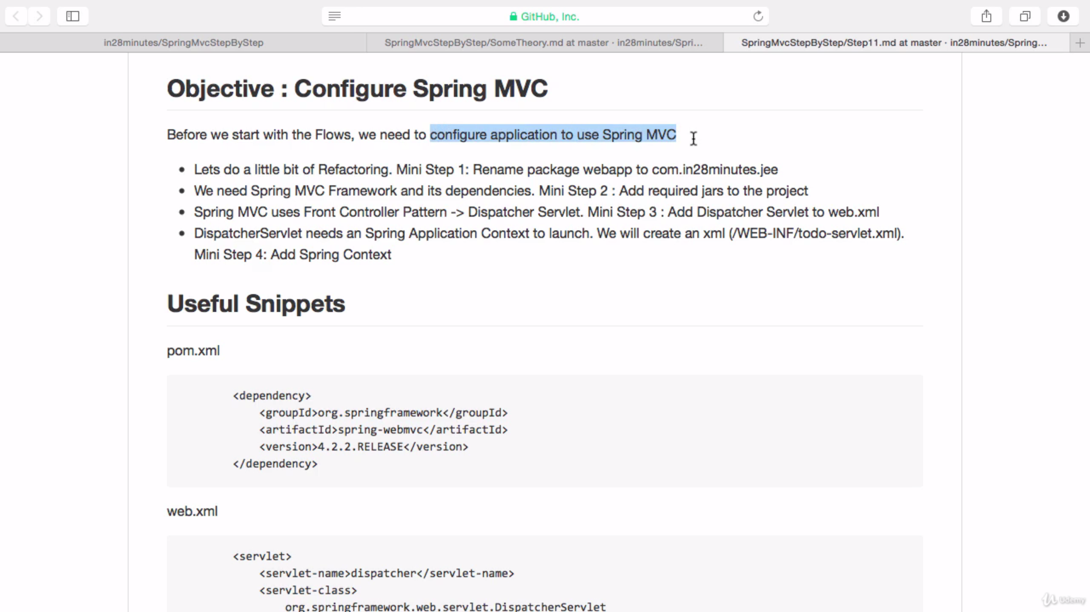

Slide 3
Front Controller pattern : Any request is first sent to dispatcher servlet, then it sent to any other controller or JSP.
Dispatcher servlet based on url, and then it finds the login controller.
I have typed the url like this : http://localhost:8080/spring-mvc/login
It means what ever the request url it first sent to dispatcher servlet. Then the dispatcher servlet starts looking for “/login” , this is mapped with an annotation called “@RequestMapping” in Login Controller Class.
So the control goes to that particular class and displays the content in controller method.

Slide 4
In our case it is loginController(), Once dispatcher servlet go through the controller method it basically looks for any view or jsp.
But we don’t have those right now, so in order to display the basic content(String) we use annotation called @RespondBody
This annotation tells to the dispatcher servlet that our controller class don’t have any view instead it has some message to display so you take it.
So that we can able to see Hello world message on the browser when ever we enter : http://localhost:8080/spring-mvc/login.
the above url.
We are going to learn how to use views in next slides

Slide 5
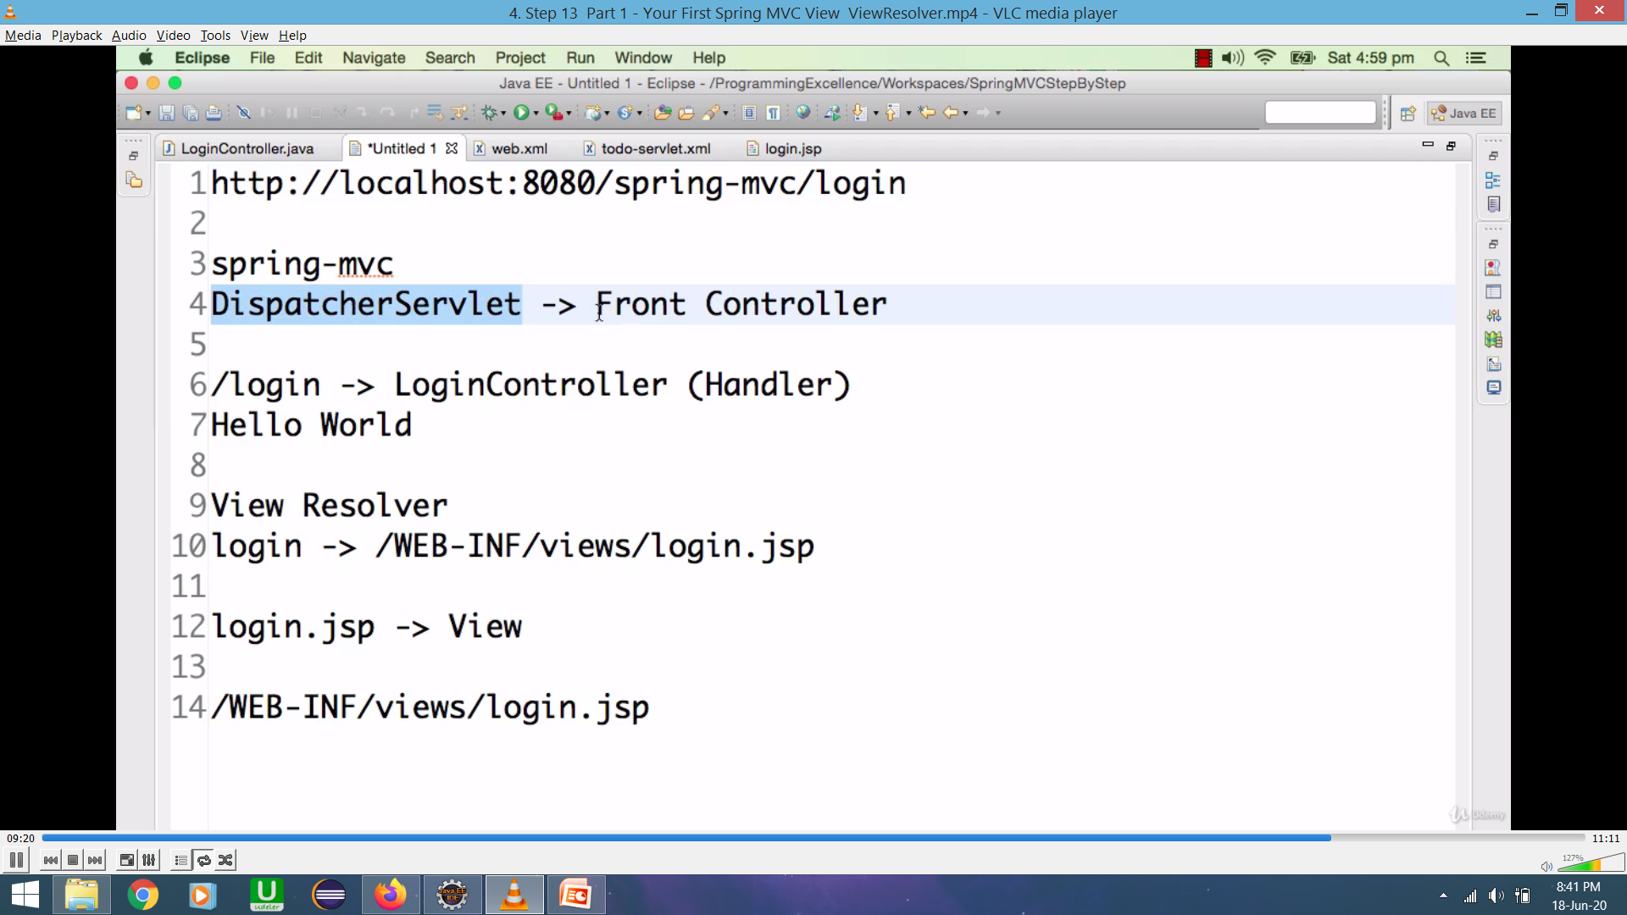
Flow control

Slide 6
View Resolver:
When ever we don’t have @ResponseBody annotation, in the login Controllerclass, the we need to mention ViewResolver. So Dispatcher servlet can use it.
View Resolver will prepend the prefix and append the suffix to the view name.
Ex: Name of the view : login
View Resolver /WEB-INF/views/login.jsp

Slide 7
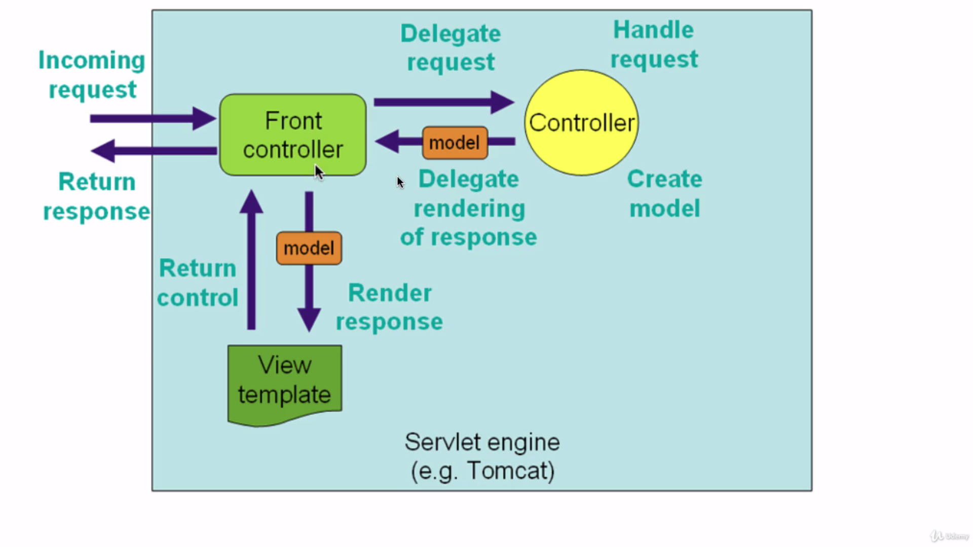
Spring MVC architecture

Slide 8
Front Controller finds the right ControllerClass(Handler), Front controller look at the subsequent part of the url ,in our case “/login”
I f any class is annotated with “/login”, it would find the controller method in that handler class, and execute that method.
Then the handler class returns front controller ,that which view(login.jsp) should return.
Then the front controller uses View resolver, there it prepend the prefix and append the suffix, and then sent back to the front controller.
At the end front controller sent this response back to browser.

Slide 9
Errors
org.springframework.beans.factory.BeanDefinitionStoreException: IOException parsing XML document from ServletContext resource [/WEB-INF/todo-servlet1.xml]; nested exception is java.io.FileNotFoundException: Could not open ServletContext resource
The servlet “todo-servlet1.xml” is not available in the specified address, or you need to check the name of the servlet properly. Or the servlet was not properly configured.
Exception unloading sessions to persistent storage
java.io.FileNotFoundException: H:\5.In 28 Mins\Spring_MVC\first-web-application\target\tomcat\work\Tomcat\localhost\_\SESSIONS.ser (The system cannot find the path specified)
While performing component scan Spring mvc is unable to load specified class because we may wrongly configured the package name in component scan element in “todo-servlet.xml”.

Slide 10
If u get the error : HTTP request status 404 error , Make you have given right package name in component scan element.

Slide 11
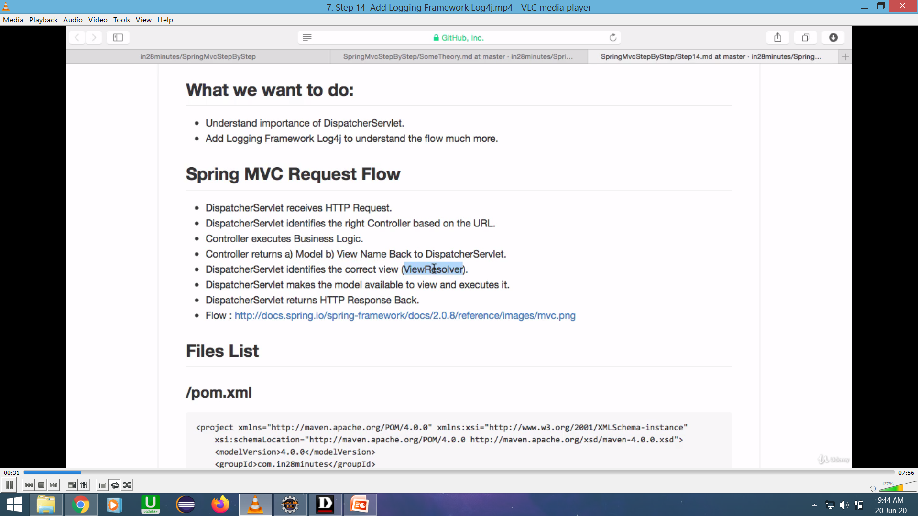

Slide 12
Log4j.jar
Spring frame work used commons logger by default.
Here we want to add log4j to pom.xml, so that we can decide what level of logging spring frame work has to use.
If we want to debug, and understand more about spring frame work , we need to add log4j.
Tip: Always use down release versions from the version being used, so that some has already played with and tell the way to solve the bugs. If you use the latest version, while you get bugs it is difficult to find the solution. You will be the first person trying to solve that bugs.

Slide 13
For reusing log4j, we need to add in log4j.properties file. In src/main/resources we need to add log4j.properties file.
We src/main/resources can add any xmls, other properties files in, If add anything in src/main/resources it will be available in class path.

Slide 14
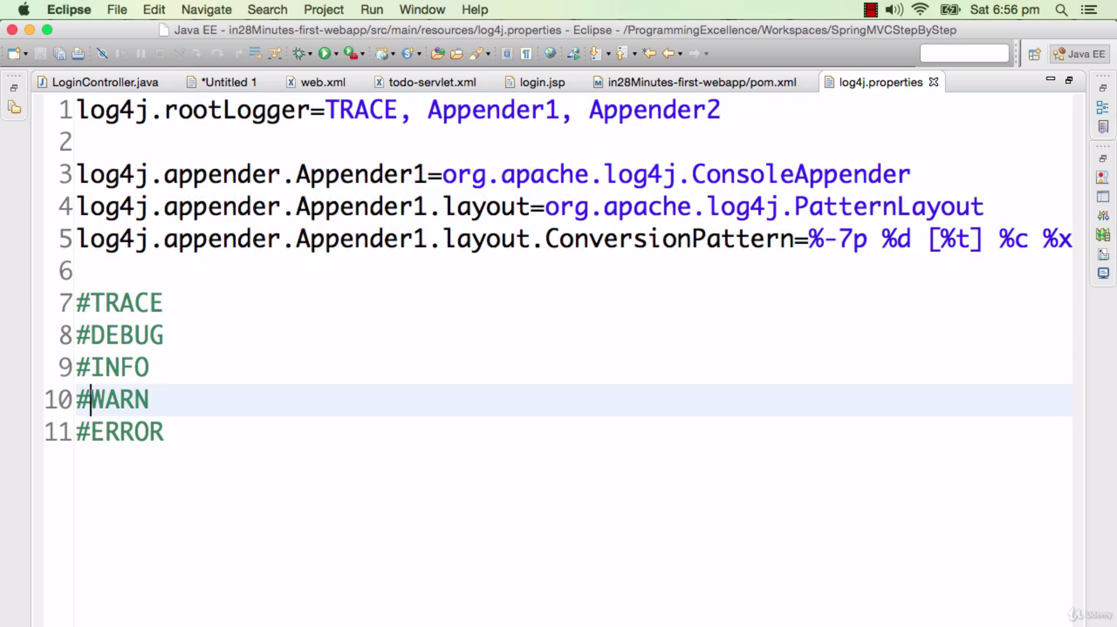

Slide 15
We have five important logging levels in log4j
#ERROR , #WARN, #INFO, #DEBUG, #TRACE,
If we use #ERROR : as logging level, then when ever we got error then there would be something in the log.
If use #WARN : More information and errors in log but only warnings
If we use #INFO : Would print Information, warnings and errors
#DEBUG : Print lot more information
#TRACE : Print absolutely everything, it will print error messages, warnings, information's, debug information also

Slide 16
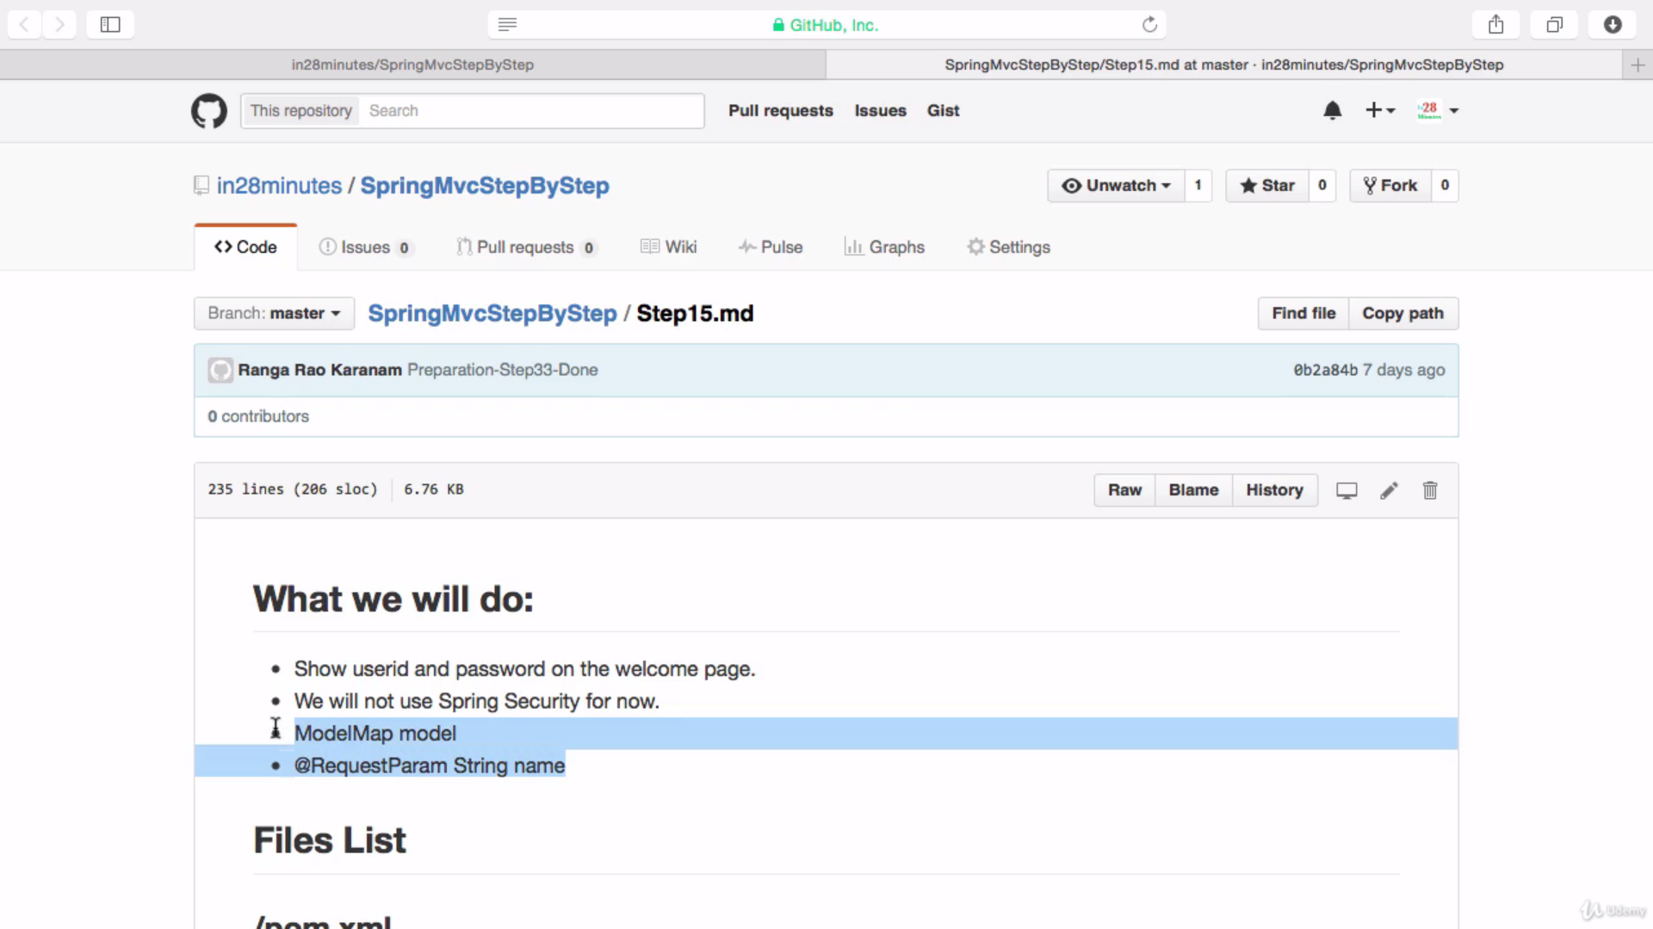

Slide 17
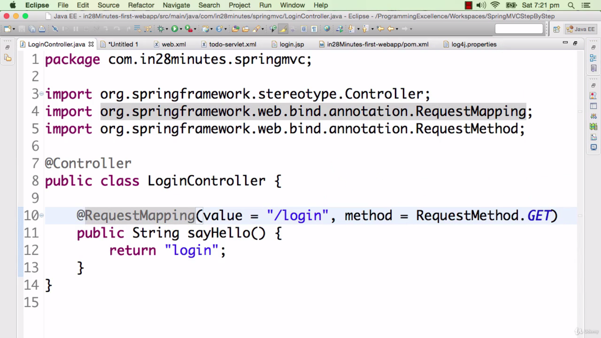
sayHello() method will try to handle all the requests like get , and post , but for now we want only to handle get request, that’s why we are forcing sayHello() method to handle only GET request. While the post req can be handled by other controller method.

Slide 18
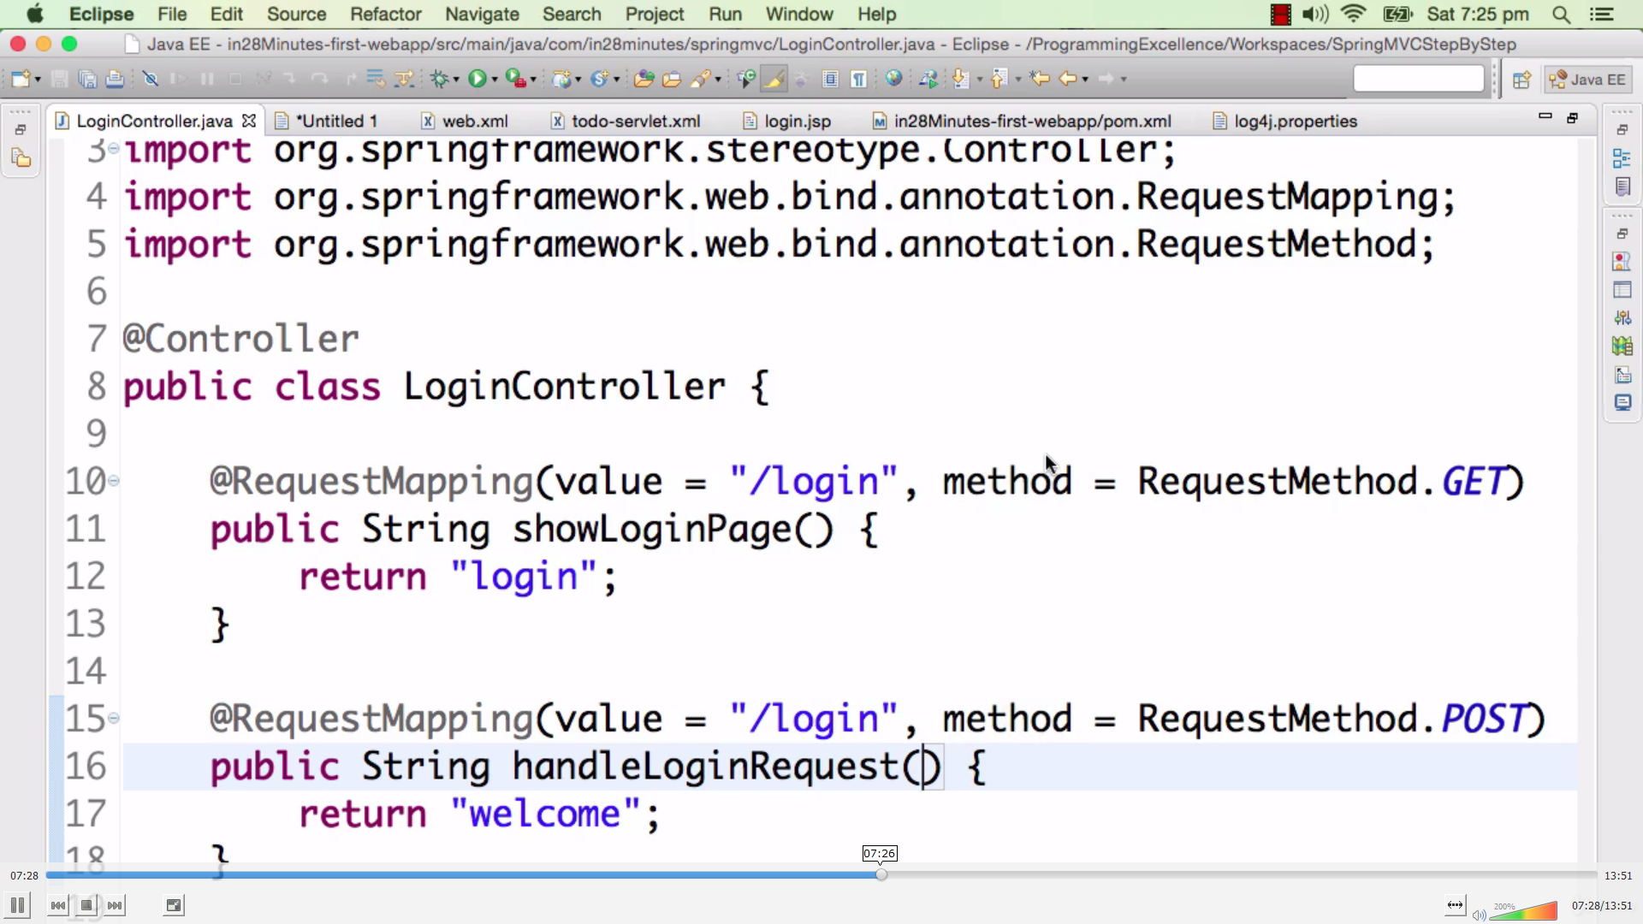
When we type the url “localhost:8080/spring-mvc/login” in the browser it is showing only welcome , it is not showing username eventhough we configured in welcome.jsp. Here inorder to fix that we need to use @RequestParam annotation and ModelMap parameter, so that we can pass the name or data to welcome.jsp,

Slide 19
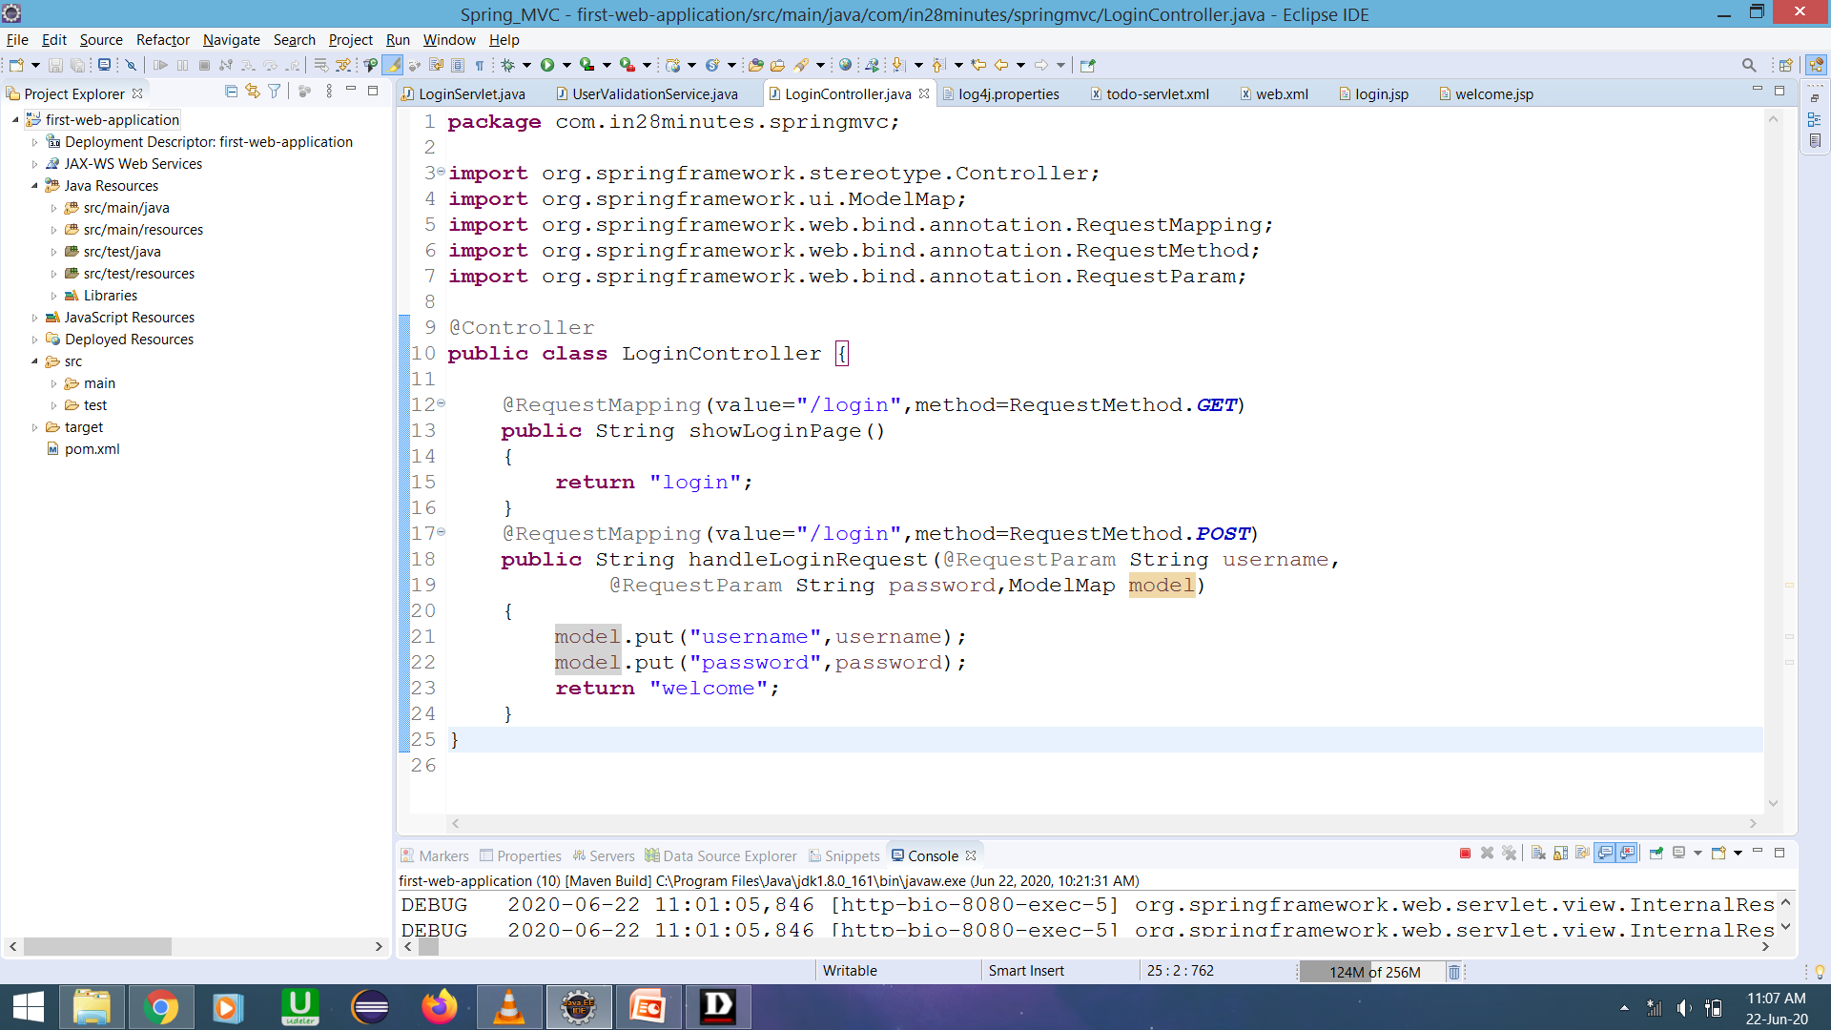
Check @RequestParam annotation and ModelMap Attribute here

Slide 20
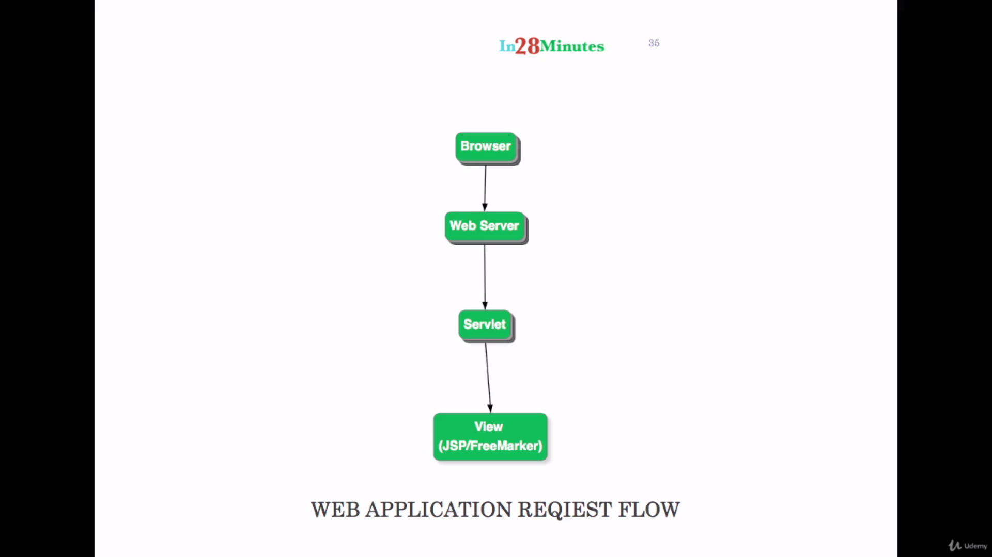

Slide 21
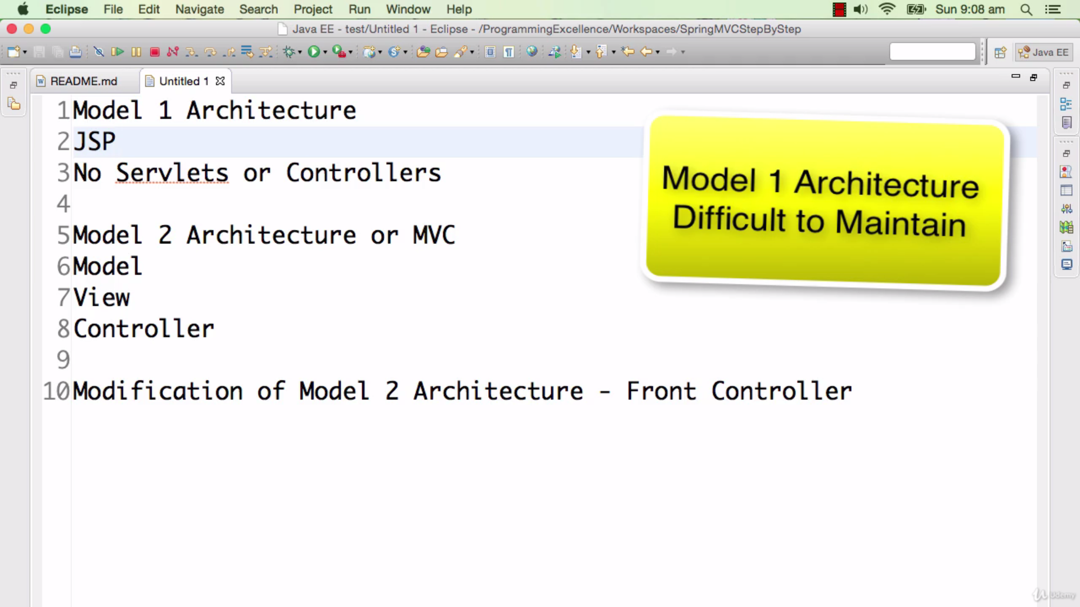

Slide 22
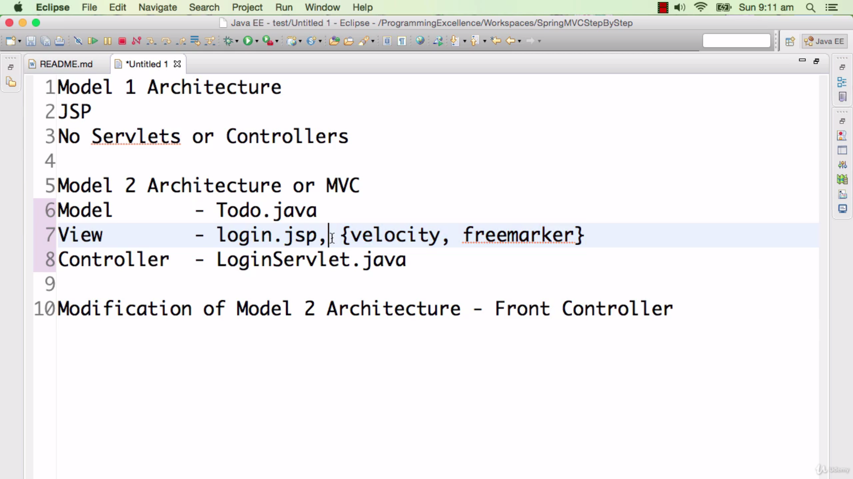

Slide 23
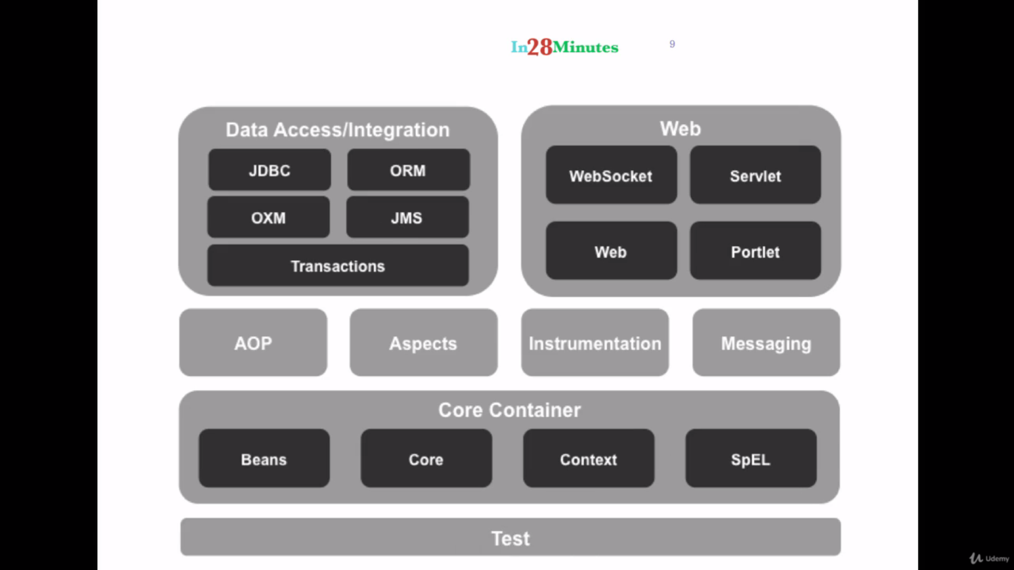

Slide 24
Request Scope
It is one call, one request from the browser, to the server and the response send back to the browser.
The time b/w initiation of the request, and the time we get back the response is called the Request scope.
Anything we put in the model in spring mvc , it is the part of Request scope by default.
So what ever we put in the model it is only available during the request scope.
Once the request is over the model will be removed, so we can’t use the data in that model in later requests.

Slide 25
Session Scope
Session scope is basically , from log in to till logout, all until your session expires ,we can make the data (name) available in session.
Let us for an example , the user Yogesh is logged in using his user name, So we have to make his name available till his session ends. We don’t want to add name each time for different requests in the same session.
That’s why we make use of session scope. For this we have to use @SessionAttributes(“name”) annotation in LoginControl and TodoControl classes and we need to pass the data (name) in that annotation.
What ever we put inside this annotation it will available as session attributes.

Slide 26
We have to be careful that what we put in @SessionAttributes , we have to put things which are really needed in @SessionAttributes. Don’t use the session to control the flow , it is a bad practice.
Everything we put in session would occupy the memory, if we put a big object of size one mb, it affects on performance of the app’n.
If 1000 users trying to put one mb size of big object each, it lead a lot of memory waste. So it is not recommended.
If we have two controller classes, also the two classes needs the name as an attribute , then we have to use @SessionAttributes annotation in two classes as well.
If we are accessing the name attribute in further requests, we are getting it from the session not from the @RequestParam.

Slide 27
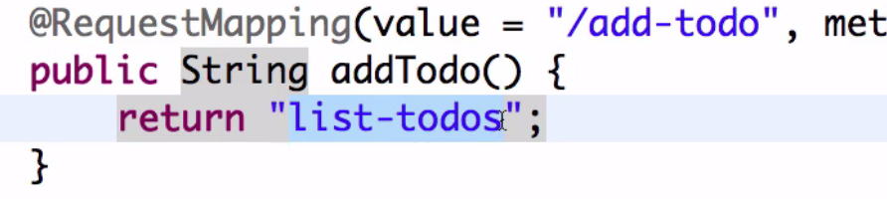
If don’t mention action in any form then form would redirected to same action from where it came in.
If we use method=“GET” in any form then parameters will passed as part of the url, So we are using “post” instead.
If we want to redirect the user after adding new todo, it won’t display any todo in “add-todo” web page, and also we can’t put the todos as a part of session. We have only one option that is redirecting.

Slide 28
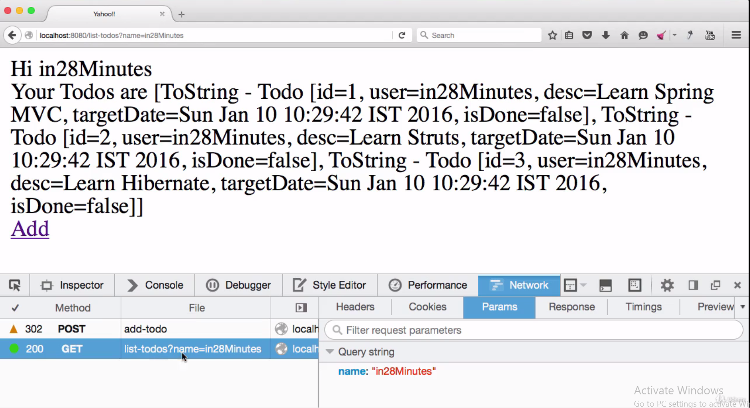

Slide 29
If we use redirect, the name is passed as a part of url as you can see in above diagram. In order to avoid this we have to use model.clear() method. Then you can see name doesn’t pass as a part of url.
JSTL: Jsp standard Tag Library
There is a for loop tag in JSTL, it is almost similar to normal for loop in our java.
If we want to use property of any built in class, we need to import that particular class. In the same way we need import a tag library and we have give a prefix(c) to it.
The prefix is the class name that we refer to this tag library. Then after if I type <c: something> , it then the request goes to this tag library.
Also we need to add jstl maven dependency in pom.xml file.

Slide 30
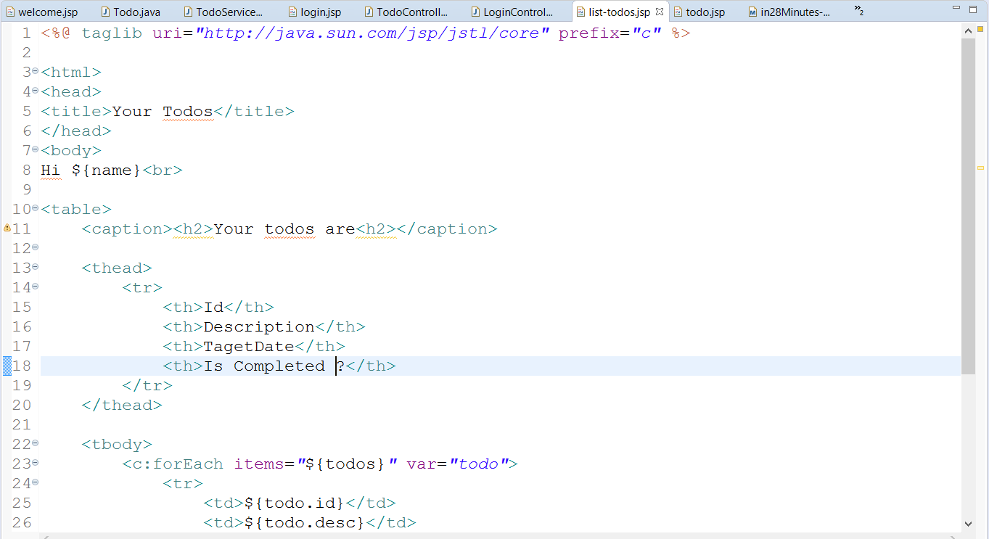
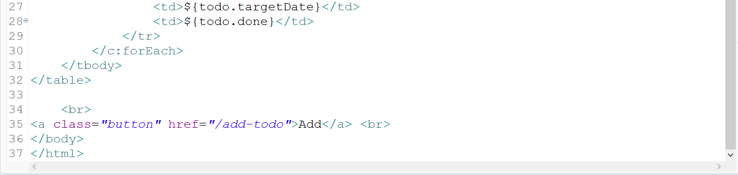

Slide 31
We can create tables in jsp,
<table></table> -- Define a table
<caption></caption> -- Small Description about table
<thead></thead> -- Table headings
<tbody></tbody> -- Table body
<tr></tr> -- Table rows
<th></th> -- Headings inside table
<td></td> -- Data inside table

Slide 32
If we want to make use Bootstrap, we can make maven to download by adding a dependency. We can add a web jar in pom.xml and use new functionalities.
Ex web jars : bootstrap, jquery.
Bootstrap internally uses jquery,, so we need to add jquery dependency also.
NOTE: We will add style sheets in the head and java scripts in bottom of the html page (just before closing tags).
We are using bootstrap.min.css in resources. Bootstrap.css is a huge file and every time the Bootstrap.css is gets transformed from the server to the browser we will use minified version of that jars. Minfied is simply like zipped version. So the application launches up much more quickly.
We use container class from css, So the data in the html page won’t start from edge of the page. We will get Well defined format if we use container class.

